Slide 1

Introduction to Probabilistic Machine Learning
Ralf Herbrich, Jakob Walter
Graphical Models

Slide 2
Overview
Graphical Models
Bayesian Networks and Conditional Independence
Factor Graphs and Sum-Product Algorithm
Approximate Message Passing and Expectation Propagation

Slide 3
Overview
Graphical Models
Bayesian Networks and Conditional Independence
Factor Graphs and Sum-Product Algorithm
Approximate Message Passing and Expectation Propagation

Slide 4
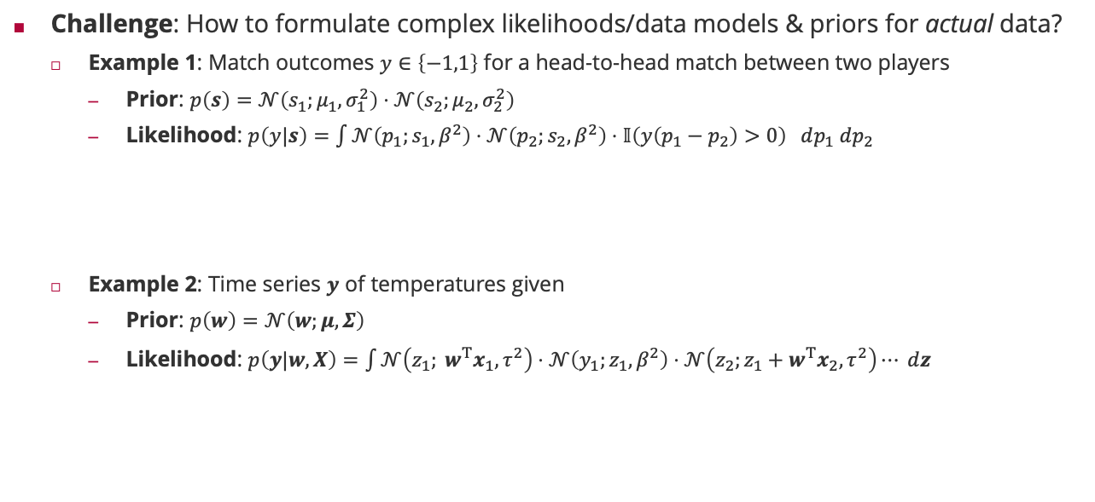
Graphical Models
Challenge: How to formulate complex likelihoods/data models & priors for actual data?
Example 1: Match outcomes $y∈\left\{−1,1\right\}$ for a head-to-head match between two players
Prior: $p\left(s\right)=𝒩\left(s_{1};μ_{1},σ_{1}^{2}\right)⋅𝒩\left(s_{2};μ_{2},σ_{2}^{2}\right)$
Likelihood: $p\left(y|s\right)=\int{𝒩\left(p_{1};s_{1},β^{2}\right)⋅𝒩\left(p_{2};s_{2},β^{2}\right)⋅𝕀\left(y\left(p_{1}−p_{2}\right)>0\right) dp_{1} dp_{2}}$
Example 2: Time series $y$ of temperatures given
Prior: $p\left(w\right)=𝒩\left(w;μ,Σ\right)$
Likelihood: $p\left(y|w,X\right)=\int{𝒩\left(z_{1}; w^{T}x_{1},τ^{2}\right)⋅𝒩\left(y_{1};z_{1},β^{2}\right)⋅𝒩\left(z_{2};z_{1}+w^{T}x_{2},τ^{2}\right)⋯ dz}$
skill belief
marginalization
Match outcome
Player performance
External state mapping parameter belief
marginalization
Dynamics model
Observed temperature model
Conditional hidden state model

Slide 5















Graphical Models
Observation: The product structure of the probabilities seems crucial!
Idea: Define a graph where each of the variables are nodes and edges indicate relationships between variables
Advantages: Simple way to visualize factor structure of the joint probability
Bayesian Networks: Insights into (conditional) independence based on graph properties
Factor Graphs: Insights into efficient inference and approximation algorithms
$$𝒩\left(s_{1};μ_{1},σ_{1}^{2}\right)⋅𝒩\left(s_{2};μ_{2},σ_{2}^{2}\right)⋅𝒩\left(p_{1};s_{1},β^{2}\right)⋅𝒩\left(p_{2};s_{2},β^{2}\right)⋅𝕀\left(y\left(p_{1}−p_{2}\right)>0\right)$$
$$𝒩\left(w;μ,Σ\right)⋅𝒩\left(z_{1}; w^{T}x_{1},τ^{2}\right)⋅𝒩\left(y_{1};z_{1},β^{2}\right)⋅𝒩\left(z_{2};z_{1}+w^{T}x_{2},τ^{2}\right)⋅𝒩\left(y_{2};z_{2},β^{2}\right)⋯$$
$$s_{1}$$
$$s_{2}$$
$$x_{1}$$
$$x_{2}$$
$$x_{3}$$
$$p_{1}$$
$$p_{2}$$
$$w$$
$$z_{1}$$
$$z_{2}$$
$$z_{3}$$
$$y$$
$$y_{1}$$
$$y_{2}$$
$$y_{3}$$

Slide 6
Overview
Graphical Models
Bayesian Networks and Conditional Independence
Factor Graphs and Sum-Product Algorithm
Approximate Message Passing and Expectation Propagation

Slide 7

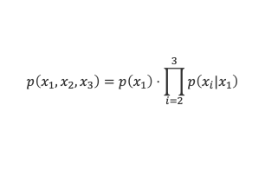





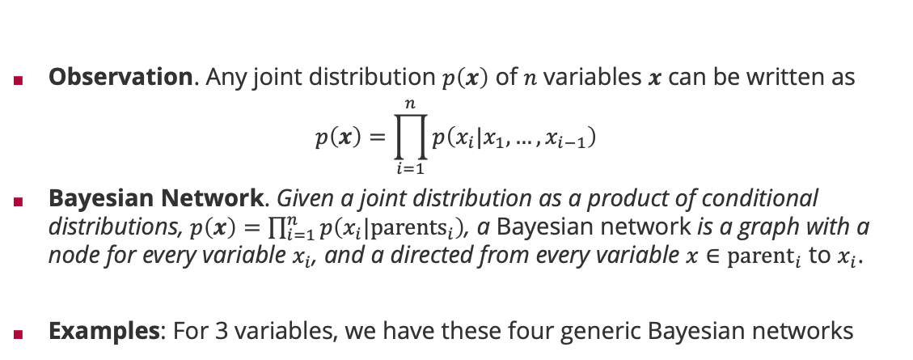




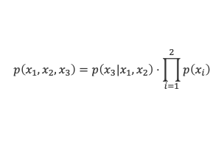



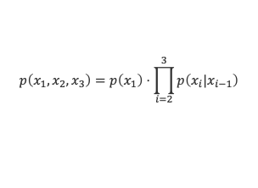
Bayesian Networks
Observation. Any joint distribution $p\left(x\right)$ of $n$ variables $x$ can be written as
$$p\left(x\right)=\prod_{i=1}^{n}{p\left(x_{i}|x_{1},…,x_{i−1}\right)}$$
Bayesian Network. Given a joint distribution as a product of conditional distributions, $p\left(x\right)=\prod_{i=1}^{n}{p\left(x_{i}|{parents}_{i}\right)}$, a Bayesian network is a graph with a node for every variable $x_{i}$, and a directed from every variable $x∈{parent}_{i}$ to $x_{i}$.
Examples: For 3 variables, we have these four generic Bayesian networks
$$x_{1}$$
$$x_{2}$$
$$x_{1}$$
$$x_{2}$$
$$x_{1}$$
$$x_{2}$$
$$x_{1}$$
$$x_{2}$$
$$x_{3}$$
$$x_{3}$$
$$x_{3}$$
$$x_{3}$$
$$p\left(x_{1},x_{2},x_{3}\right)=p\left(x_{1}\right)⋅p\left(x_{2}|x_{1}\right)⋅p\left(x_{3}|x_{1},x_{2}\right)$$
$$p\left(x_{1},x_{2},x_{3}\right)=p\left(x_{1}\right)⋅\prod_{i=2}^{3}{p\left(x_{i}|x_{1}\right)}$$
$$p\left(x_{1},x_{2},x_{3}\right)=p\left(x_{1}\right)⋅\prod_{i=2}^{3}{p\left(x_{i}|x_{i−1}\right)}$$
$$p\left(x_{1},x_{2},x_{3}\right)=p\left(x_{3}|x_{1},x_{2}\right)⋅\prod_{i=1}^{2}{p\left(x_{i}\right)}$$
full mesh
star
chain
sink

Slide 8






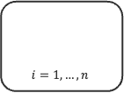


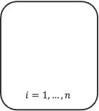



Bayesian Network Models
$$p\left(x_{1},x_{2},x_{3}\right)=p\left(x_{1}\right)⋅\prod_{i=2}^{n}{p\left(x_{i}|x_{1}\right)}$$
Plates. If a subset of variables has the same relation only differing in their index, we use a ”plate” to collapse them into a single graphical element.
Increase readability of models for large amounts of parameters and data
A Bayesian network must always be a directed acyclic graph because only those have a topological order corresponding to a variable order.
Observed Variables. If a subset of variables has been observed (“data”), the variable nodes are usually shaded (“clamped”)
Examples:
$$x_{1}$$
$$i=2,…,n$$
$$x_{i}$$
Linear Regression
Linear Classification
$$w$$
$$w$$
$$i=1,…,n$$
$$i=1,…,n$$
$x_{i}$
$$y_{i}$$
$x_{i}$
$$t_{i}$$
$$y_{i}$$

Slide 9

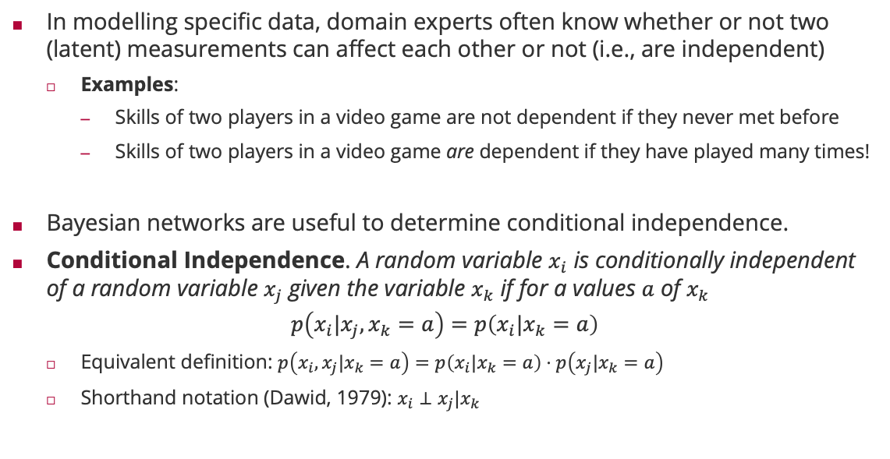
Conditional Independence
In modelling specific data, domain experts often know whether or not two (latent) measurements can affect each other or not (i.e., are independent)
Examples:
Skills of two players in a video game are not dependent if they never met before
Skills of two players in a video game are dependent if they have played many times!
Bayesian networks are useful to determine conditional independence.
Conditional Independence. A random variable $x_{i}$ is conditionally independent of a random variable $x_{j}$ given the variable $x_{k}$ if for a values $a$ of $x_{k}$
$$p\left(x_{i}|x_{j},x_{k}=a\right)=p\left(x_{i}|x_{k}=a\right)$$
Equivalent definition: $p\left(x_{i},x_{j}|x_{k}=a\right)=p\left(x_{i}|x_{k}=a\right)⋅p\left(x_{j}|x_{k}=a\right)$
Shorthand notation (Dawid, 1979): $x_{i}⊥x_{j}|x_{k}$
Philip Dawid (1946– )

Slide 10















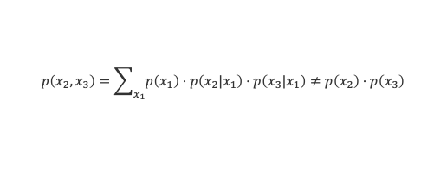
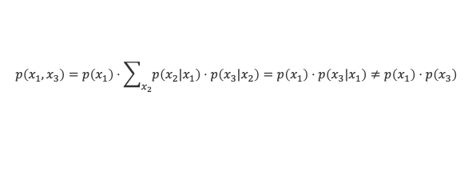
Conditional Independence: Warm-Up I
Tail-to-Tail Node ($x_{1}$): $p\left(x_{1},x_{2},x_{3}\right)=p\left(x_{1}\right)⋅p\left(x_{2}|x_{1}\right)⋅p\left(x_{3}|x_{1}\right)$
Head-to-Tail Node ($x_{2}$): $p\left(x_{1},x_{2},x_{3}\right)=p\left(x_{1}\right)⋅p\left(x_{2}|x_{1}\right)⋅p\left(x_{3}|x_{2}\right)$
$$x_{1}$$
$$x_{1}$$
$$x_{3}$$
$$x_{2}$$
$$x_{3}$$
$$x_{2}$$
$$p\left(x_{2},x_{3}\right)=\sum_{x_{1}}{p\left(x_{1}\right)⋅p\left(x_{2}|x_{1}\right)⋅p\left(x_{3}|x_{1}\right)}≠p\left(x_{2}\right)⋅p\left(x_{3}\right)$$
$$p\left(x_{2},x_{3}|x_{1}\right)=\frac{p\left(x_{1}\right)⋅p\left(x_{2}|x_{1}\right)⋅p\left(x_{3}|x_{1}\right)}{p\left(x_{1}\right)}=p\left(x_{2}|x_{1}\right)⋅p\left(x_{3}|x_{1}\right)$$
not (always) conditionally independent
conditionally independent
$$x_{1}$$
$$x_{2}$$
$$x_{3}$$
$$x_{1}$$
$$x_{2}$$
$$x_{3}$$
$$p\left(x_{1},x_{3}\right)=p\left(x_{1}\right)⋅\sum_{x_{2}}{p\left(x_{2}|x_{1}\right)⋅p\left(x_{3}|x_{2}\right)}=p\left(x_{1}\right)⋅p\left(x_{3}|x_{1}\right)≠p\left(x_{1}\right)⋅p\left(x_{3}\right)$$
$$p\left(x_{1},x_{3}|x_{2}\right)=\frac{p\left(x_{2}|x_{1}\right)⋅p\left(x_{1}\right)}{p\left(x_{2}\right)}⋅p\left(x_{3}|x_{2}\right)=p\left(x_{1}|x_{2}\right)⋅p\left(x_{3}|x_{2}\right)$$
not (always) conditionally independent
conditionally independent

Slide 11











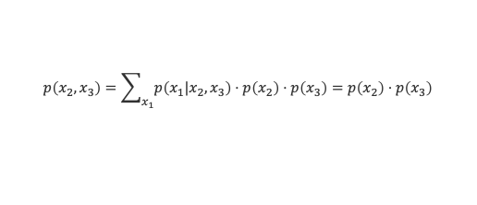









Conditional Independence: Warm-Up II
Head-to-Head Node ($x_{1}$): $p\left(x_{1},x_{2},x_{3}\right)=p\left(x_{2}\right)⋅p\left(x_{3}\right)⋅p\left(x_{1}|x_{2},x_{3}\right)$
It can be shown that the path between $x_{2}$ and $x_{3}$ become are only independent if none of the descendant node from $x_{1}$ (that can be reached in the directed graph) is observed!
Skill Example (ctd): Consider the skills of two players
$$x_{3}$$
$$x_{2}$$
$$x_{3}$$
$$x_{2}$$
$$x_{1}$$
$$x_{1}$$
$$p\left(x_{2},x_{3}\right)=\sum_{x_{1}}{p\left(x_{1}|x_{2},x_{3}\right)⋅p\left(x_{2}\right)⋅p\left(x_{3}\right)}=p\left(x_{2}\right)⋅p\left(x_{3}\right)$$
$$p\left(x_{2},x_{3}|x_{1}\right)=\frac{p\left(x_{1}|x_{2},x_{3}\right)⋅p\left(x_{2}\right)⋅p\left(x_{3}\right)}{p\left(x_{1}\right)}≠p\left(x_{2}|x_{1}\right)⋅p\left(x_{3}|x_{1}\right)$$
(conditionally) independent
(possibly) conditionally dependent
$$s_{1}$$
$$s_{2}$$
$$s_{1}$$
$$s_{2}$$
$$p_{1}$$
$$p_{2}$$
$$p_{1}$$
$$p_{2}$$
$$y$$
$$y$$
Before match: $s_{1}$ and $s_{2}$ are independent
After macht: $s_{1} \text{and} s_{2} \text{are} \text{not} \text{independent}$

Slide 12





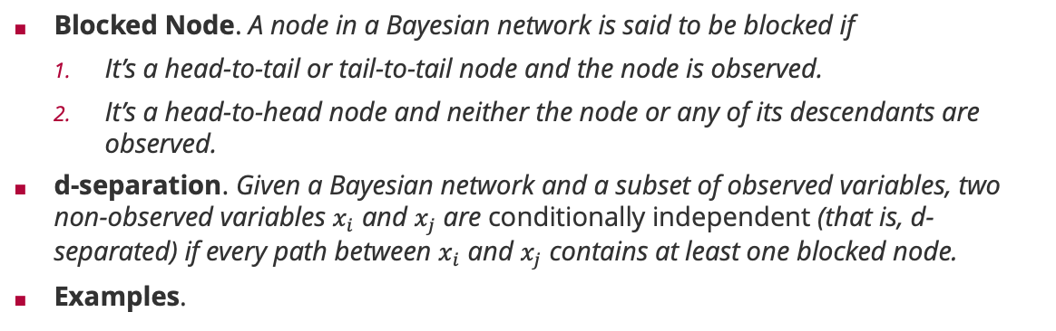








Conditional Independence: d-separation
Blocked Node. A node in a Bayesian network is said to be blocked if
It’s a head-to-tail or tail-to-tail node and the node is observed.
It’s a head-to-head node and neither the node or any of its descendants are observed.
d-separation. Given a Bayesian network and a subset of observed variables, two non-observed variables $x_{i}$ and $x_{j}$ are conditionally independent (that is, d-separated) if every path between $x_{i}$ and $x_{j}$ contains at least one blocked node.
Examples.
Judea Pearl (1936– )
$$x_{1}$$
$$x_{3}$$
$$x_{1}$$
$$x_{3}$$
$$x_{2}$$
$$x_{4}$$
$$x_{2}$$
$$x_{4}$$
$$x_{5}$$
$$x_{5}$$
$x_{1}$ and $x_{4}$ are not independent
$x_{1}$ and $x_{4}$ are independent

Slide 13
Overview
Graphical Models
Bayesian Networks and Conditional Independence
Factor Graphs and Sum-Product Algorithm
Approximate Message Passing and Expectation Propagation

Slide 14



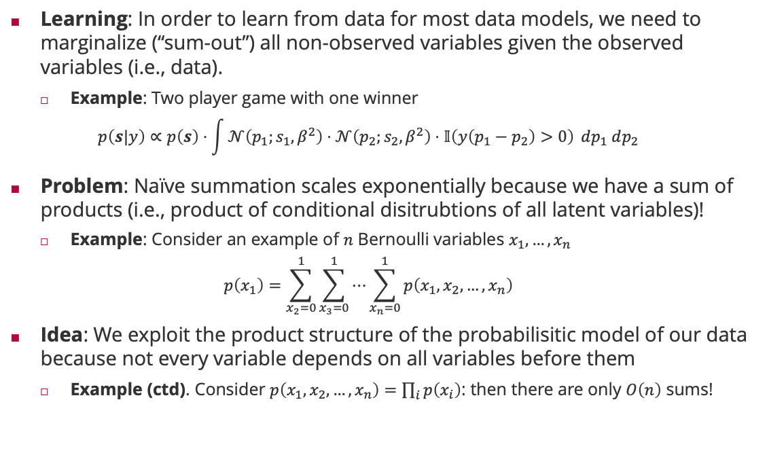



Inference in Probabilistic Models
Learning: In order to learn from data for most data models, we need to marginalize (“sum-out”) all non-observed variables given the observed variables (i.e., data).
Example: Two player game with one winner
$$p\left(s|y\right)∝p\left(s\right)⋅\int{𝒩\left(p_{1};s_{1},β^{2}\right)⋅𝒩\left(p_{2};s_{2},β^{2}\right)⋅𝕀\left(y\left(p_{1}−p_{2}\right)>0\right)} dp_{1} dp_{2}$$
Problem: Naïve summation scales exponentially because we have a sum of products (i.e., product of conditional disitrubtions of all latent variables)!
Example: Consider an example of $n$ Bernoulli variables $x_{1},…,x_{n}$
$$p\left(x_{1}\right)=\sum_{x_{2}=0}^{1}{\sum_{x_{3}=0}^{1}{⋯\sum_{x_{n}=0}^{1}{p\left(x_{1},x_{2},…,x_{n}\right)}}}$$
Idea: We exploit the product structure of the probabilisitic model of our data because not every variable depends on all variables before them
Example (ctd). Consider $p\left(x_{1},x_{2},…,x_{n}\right)=\prod_{i}{p\left(x_{i}\right)}$: then there are only $O\left(n\right)$ sums!
$$s_{1}$$
$$s_{2}$$
$$p_{1}$$
$$p_{2}$$
$$y$$
$2^{n−1}$ summations

Slide 15





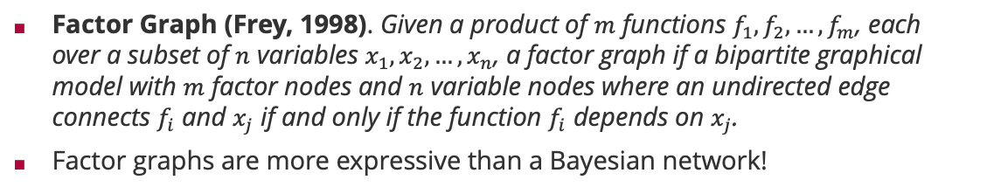








Factor Graphs
Factor Graph (Frey, 1998). Given a product of $m$ functions $f_{1},f_{2},…,f_{m}$, each over a subset of $n$ variables $x_{1},x_{2},…,x_{n}$, a factor graph if a bipartite graphical model with $m$ factor nodes and $n$ variable nodes where an undirected edge connects $f_{i}$ and $x_{j}$ if and only if the function $f_{i}$ depends on $x_{j}$.
Factor graphs are more expressive than a Bayesian network!
Brendan Frey (1968 – )
Bayesian network
Corresponding factor graph
Factor graph with more structure
$$x_{1}$$
$$x_{2}$$
$$x_{1}$$
$$x_{2}$$
$$x_{1}$$
$$x_{2}$$
$$x_{3}$$
$$x_{3}$$
$$x_{3}$$
$$p\left(x_{1},x_{2},x_{3}\right)=p\left(x_{1}\right)⋅p\left(x_{2}\right)⋅p\left(x_{3}|x_{1},x_{2}\right)$$
$$p\left(x_{1},x_{2},x_{3}\right)=f_{1}\left(x_{1}\right)⋅f_{2}\left(x_{2}\right)⋅f_{3}\left(x_{3},x_{1},x_{2}\right)$$
$$p\left(x_{1},x_{2},x_{3}\right)=f_{1}\left(x_{1}\right)⋅f_{2}\left(x_{2}\right)⋅f_{3}\left(x_{1},x_{3}\right)⋅f_{4}\left(x_{2},x_{3}\right)$$
Structure in $p\left(x_{3}|x_{1},x_{2}\right)$

Slide 16





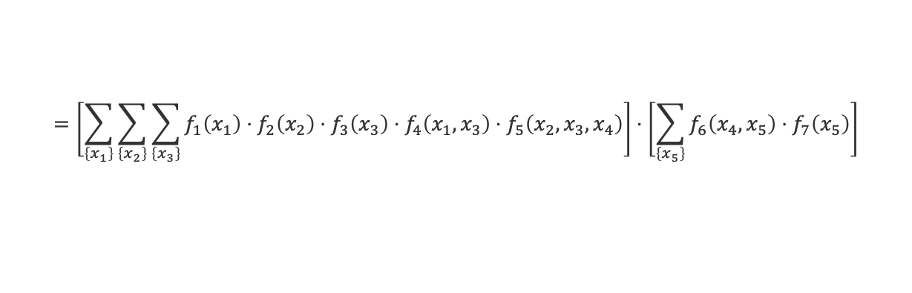












Sum-Product Algorithm: Marginals
$$f_{3}$$
$$f_{1}$$
$$f_{4}$$
$$x_{3}$$
$$x_{1}$$
$$f_{5}$$
$$f_{6}$$
$$f_{7}$$
$$x_{4}$$
$$x_{5}$$
$$f_{2}$$
$$m_{f_{5}→x_{4}}\left(x_{4}\right)$$
$$m_{f_{6}→x_{4}}\left(x_{4}\right)$$
$$x_{2}$$
$$p\left(x_{4}\right)=\sum_{\left\{x_{1}\right\}}{\sum_{\left\{x_{2}\right\}}{\sum_{\left\{x_{3}\right\}}{\sum_{\left\{x_{5}\right\}}{f_{1}\left(x_{1}\right)⋅f_{2}\left(x_{2}\right)⋅f_{3}\left(x_{2}\right)⋅f_{4}\left(x_{1},x_{3}\right)⋅f_{5}\left(x_{2},x_{3},x_{4}\right)⋅f_{6}\left(x_{4},x_{5}\right)⋅f_{7}\left(x_{5}\right)}}}}$$
$$=\left[\sum_{\left\{x_{1}\right\}}{\sum_{\left\{x_{2}\right\}}{\sum_{\left\{x_{3}\right\}}{f_{1}\left(x_{1}\right)⋅f_{2}\left(x_{2}\right)⋅f_{3}\left(x_{3}\right)⋅f_{4}\left(x_{1},x_{3}\right)⋅f_{5}\left(x_{2},x_{3},x_{4}\right)}}}\right]⋅\left[\sum_{\left\{x_{5}\right\}}{f_{6}\left(x_{4},x_{5}\right)⋅f_{7}\left(x_{5}\right)}\right]$$
$$m_{f_{5}→x_{4}}\left(x_{4}\right)$$
$$m_{f_{6}→x_{4}}\left(x_{4}\right)$$
Marginals are the product of all incoming messages from neighbouring factors!

Slide 17

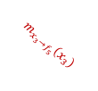
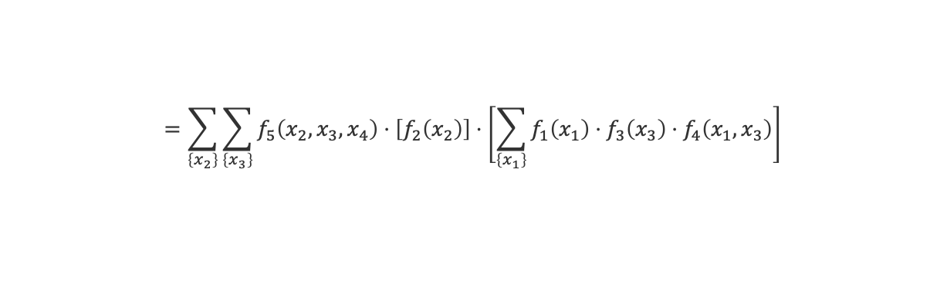

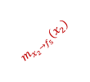





Sum-Product Algorithm: Message from Factor to Variable
$$f_{3}$$
$$f_{1}$$
$$f_{4}$$
$$x_{3}$$
$$m_{x_{3}→f_{5}}\left(x_{3}\right)$$
$$x_{1}$$
$$f_{5}$$
$$f_{6}$$
$$f_{7}$$
$$x_{4}$$
$$x_{5}$$
$$f_{2}$$
$$m_{f_{5}→x_{4}}\left(x_{4}\right)$$
$$m_{f_{6}→x_{4}}\left(x_{4}\right)$$
$$x_{2}$$
$$m_{x_{2}→f_{5}}\left(x_{2}\right)$$
$$m_{f_{5}→x_{4}}\left(x_{4}\right)=\sum_{\left\{x_{1}\right\}}{\sum_{\left\{x_{2}\right\}}{\sum_{\left\{x_{3}\right\}}{f_{1}\left(x_{1}\right)⋅f_{2}\left(x_{2}\right)⋅f_{3}\left(x_{3}\right)⋅f_{4}\left(x_{1},x_{3}\right)⋅f_{5}\left(x_{2},x_{3},x_{4}\right)}}}$$
$$=\sum_{\left\{x_{2}\right\}}{\sum_{\left\{x_{3}\right\}}{f_{5}\left(x_{2},x_{3},x_{4}\right)⋅\left[f_{2}\left(x_{2}\right)\right]⋅\left[\sum_{\left\{x_{1}\right\}}{f_{1}\left(x_{1}\right)⋅f_{3}\left(x_{3}\right)⋅f_{4}\left(x_{1},x_{3}\right)}\right]}}$$
$$m_{x_{2}→f_{5}}\left(x_{2}\right)$$
$$m_{x_{3}→f_{5}}\left(x_{3}\right)$$
Messages from a factor to a variable sum out all neighboring variables weighted by their incoming message

Slide 18




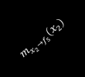






Sum-Product Algorithm: Message from Variable to Factor
$$f_{3}$$
$$m_{f_{3}→x_{3}}\left(x_{3}\right)$$
$$f_{1}$$
$$f_{4}$$
$$x_{3}$$
$$m_{x_{3}→f_{5}}\left(x_{3}\right)$$
$$x_{1}$$
$$f_{5}$$
$$f_{6}$$
$$f_{7}$$
$$m_{f_{4}→x_{3}}\left(x_{3}\right)$$
$$x_{4}$$
$$x_{5}$$
$$f_{2}$$
$$m_{f_{5}→x_{4}}\left(x_{4}\right)$$
$$m_{f_{6}→x_{4}}\left(x_{4}\right)$$
$$x_{2}$$
$$m_{x_{2}→f_{5}}\left(x_{2}\right)$$
$$m_{x_{3}→f_{5}}\left(x_{3}\right)=\sum_{\left\{x_{1}\right\}}{f_{1}\left(x_{1}\right)⋅f_{3}\left(x_{3}\right)⋅f_{4}\left(x_{1},x_{3}\right)}$$
$$=\left[f_{3}\left(x_{3}\right)\right]⋅\left[\sum_{\left\{x_{1}\right\}}{f_{1}\left(x_{1}\right)⋅f_{4}\left(x_{1},x_{3}\right)}\right]$$
$$m_{f_{3}→x_{3}}\left(x_{3}\right)$$
$$m_{f_{4}→x_{3}}\left(x_{3}\right)$$
Messages from a variable to a factor multiply incoming message from neighboring factors

Slide 19


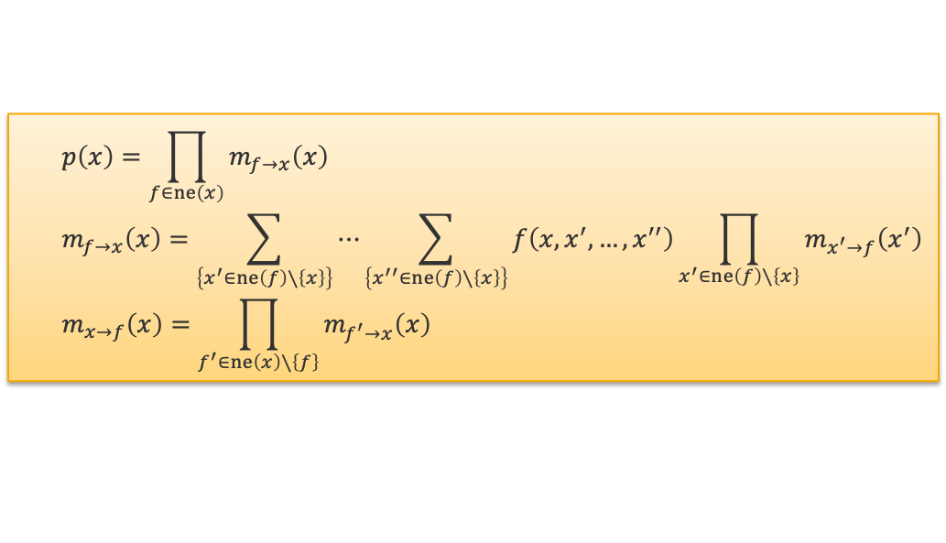
Sum-Product Algorithm
Sum-Product Algorithm (Aji-McEliece, 1997). Putting it all together, we have
Basis: Generalized distributive law (which also holds for max-product)
Efficiency: By storing messages, we
Only have to compute local summations in $O\left(2^{T}\right)$ where tree-width $T=\max_{f}\left|ne\left(f\right)\right|$!
All marginals can be computed recursively in $O\left(E⋅2^{T}\right)$ vs $O\left(2^{n}\right)$!
$$p\left(x\right)=\prod_{f∈ne\left(x\right)}{m_{f→x}\left(x\right)}$$
$$m_{f→x}\left(x\right)=\sum_{\left\{x^{′}∈ne\left(f\right)∖\left\{x\right\}\right\}}{⋯\sum_{\left\{x^{′′}∈ne\left(f\right)∖\left\{x\right\}\right\}}{f\left(x,x^{′},…,x^{′′}\right)\prod_{x^{′}∈ne\left(f\right)∖\left\{x\right\}}{m_{x^{′}→f}\left(x^{′}\right)}}}$$
$$m_{x→f}\left(x\right)=\prod_{f^{′}∈ne\left(x\right)∖\left\{f\right\}}{m_{f^{′}→x}\left(x\right)}$$
Robert McEliece (1942 – 2019)

Slide 20

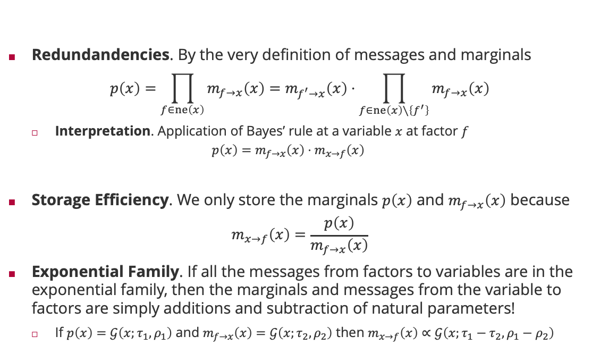

Even more efficiency
Redundandencies. By the very definition of messages and marginals
$$p\left(x\right)=\prod_{f∈ne\left(x\right)}{m_{f→x}\left(x\right)}=m_{f^{′}→x}\left(x\right)⋅\prod_{f∈ne\left(x\right)∖\left\{f^{′}\right\}}{m_{f→x}\left(x\right)}$$
Interpretation. Application of Bayes’ rule at a variable $x$ at factor $f$
$$p\left(x\right)=m_{f→x}\left(x\right)⋅m_{x→f}\left(x\right)$$
Storage Efficiency. We only store the marginals $p\left(x\right)$ and $m_{f→x}\left(x\right)$ because
$$m_{x→f}\left(x\right)=\frac{p\left(x\right)}{m_{f→x}\left(x\right)}$$
Exponential Family. If all the messages from factors to variables are in the exponential family, then the marginals and messages from the variable to factors are simply additions and subtraction of natural parameters!
If $p\left(x\right)=𝒢\left(x;τ_{1},ρ_{1}\right)$ and $m_{f→x}\left(x\right)=𝒢\left(x;τ_{2},ρ_{2}\right)$ then $m_{x→f}\left(x\right)∝𝒢\left(x;τ_{1}−τ_{2},ρ_{1}−ρ_{2}\right)$
$$m_{x→f^{′}}\left(x\right)$$
posterior
Likelihood $×$ normalization
prior

Slide 21





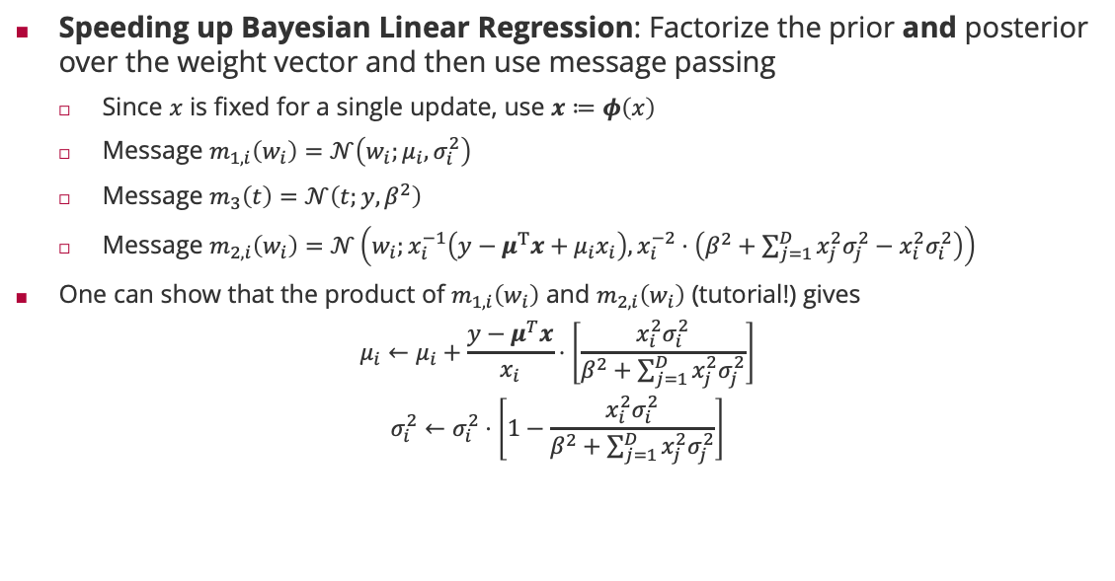








Fast Bayesian Linear Regression
$$𝒩\left(w_{1};μ_{1},σ_{1}^{2}\right)$$
$$𝒩\left(w_{D};μ_{D},σ_{D}^{2}\right)$$
Speeding up Bayesian Linear Regression: Factorize the prior and posterior over the weight vector and then use message passing
Since $x$ is fixed for a single update, use $x≔φ\left(x\right)$
Message $m_{1,i}\left(w_{i}\right)=𝒩\left(w_{i};μ_{i},σ_{i}^{2}\right)$
Message $m_{3}\left(t\right)=𝒩\left(t;y,β^{2}\right)$
Message $m_{2,i}\left(w_{i}\right)=𝒩\left(w_{i};x_{i}^{−1}\left(y−μ^{T}x+μ_{i}x_{i}\right),x_{i}^{−2}⋅\left(β^{2}+\sum_{j=1}^{D}{x_{j}^{2}σ_{j}^{2}}−x_{i}^{2}σ_{i }^{2}\right)\right)$
One can show that the product of $m_{1,i}\left(w_{i}\right)$ and $m_{2,i}\left(w_{i}\right)$ (tutorial!) gives
$$μ_{i}←μ_{i}+\frac{y−μ^{T}x}{x_{i}}⋅\left[\frac{x_{i }^{2}σ_{i}^{2}}{β^{2}+\sum_{j=1}^{D}{x_{j}^{2}σ_{j}^{2}}}\right]$$
$$σ_{i}^{2}←σ_{i}^{2}⋅\left[1−\frac{x_{i }^{2}σ_{i}^{2}}{β^{2}+\sum_{j=1}^{D}{x_{j}^{2}σ_{j}^{2}}}\right]$$
$$m_{1,1}\left(w_{1}\right)$$
$$m_{1,D}\left(w_{D}\right)$$
$$w_{1}$$
$$m_{2,i}\left(w_{i}\right)$$
$$w_{D}$$
$$𝕀\left(t=w^{T}φ\left(x\right)\right)$$
$$m_{3}\left(t\right)$$
$$t$$
$$m_{3}\left(t\right)$$
$$𝒩\left(t;y,β^{2}\right)$$
target mismatch is measured in units of $x_{i}$
largest for parameter with largest uncertainty so far
multiplicative update

Slide 22
Speeding up Bayesian Linear Regression
Nearly orthogonal features
Weakly correlated features
Strongly correlated features

Slide 23
Overview
Graphical Models
Bayesian Networks and Conditional Independence
Factor Graphs and Sum-Product Algorithm
Approximate Message Passing and Expectation Propagation

Slide 24
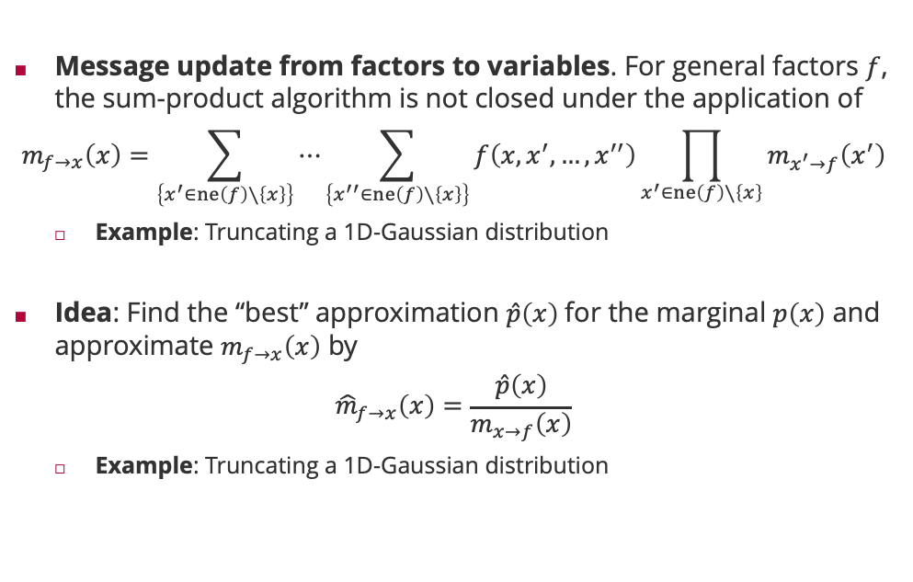
Approximate Message Passing
Message update from factors to variables. For general factors $f$, the sum-product algorithm is not closed under the application of
$$m_{f→x}\left(x\right)=\sum_{\left\{x^{′}∈ne\left(f\right)∖\left\{x\right\}\right\}}{⋯\sum_{\left\{x^{′′}∈ne\left(f\right)∖\left\{x\right\}\right\}}{f\left(x,x^{′},…,x^{′′}\right)\prod_{x^{′}∈ne\left(f\right)∖\left\{x\right\}}{m_{x^{′}→f}\left(x^{′}\right)}}}$$
Example: Truncating a 1D-Gaussian distribution
Idea: Find the “best” approximation $\hat{p}\left(x\right)$for the marginal $p\left(x\right)$ and approximate $m_{f→x}\left(x\right)$ by
$${\hat{m}}_{f→x}\left(x\right)=\frac{\hat{p}\left(x\right)}{m_{x→f}\left(x\right)}$$
Example: Truncating a 1D-Gaussian distribution

Slide 25
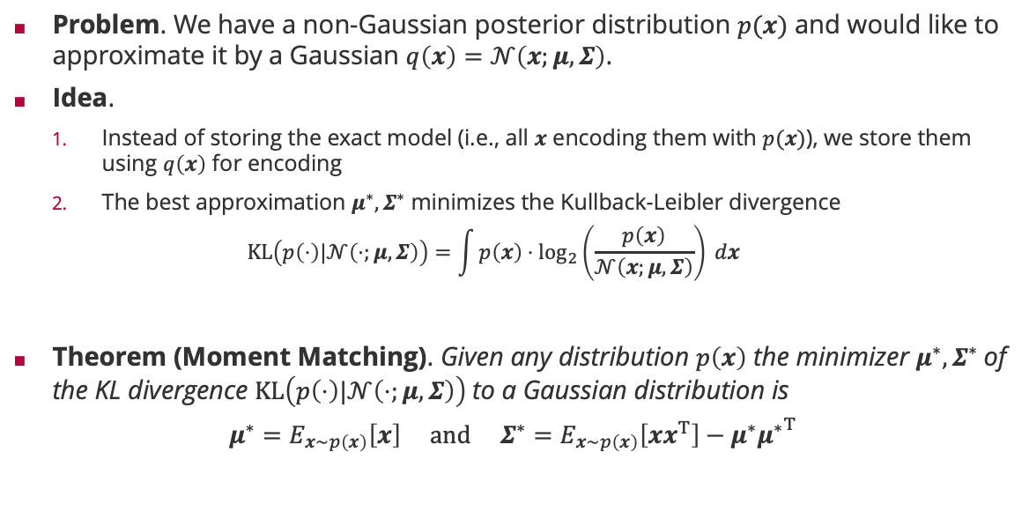
Information Theoretic Approximation: KL Divergence
Problem. We have a non-Gaussian posterior distribution $p(x)$ and would like to approximate it by a Gaussian $q\left(x\right)=𝒩\left(x;μ,Σ\right)$.
Idea.
Instead of storing the exact model (i.e., all $x$ encoding them with $p(x)$), we store them using $q\left(x\right)$ for encoding
The best approximation $μ^{∗},Σ^{∗}$ minimizes the Kullback-Leibler divergence
$$KL\left(p\left(⋅\right)|𝒩\left(⋅;μ,Σ\right)\right)=\int{p\left(x\right)⋅\log_{2}\left(\frac{p\left(x\right)}{𝒩\left(x;μ,Σ\right)}\right) dx}$$
Theorem (Moment Matching). Given any distribution $p\left(x\right)$ the minimizer $μ^{∗},Σ^{∗}$of the KL divergence $KL\left(p\left(⋅\right)|𝒩\left(⋅;μ,Σ\right)\right)$to a Gaussian distribution is
$$μ^{∗}=E_{x∼p\left(x\right)}\left[x\right] and Σ^{∗}=E_{x∼p\left(x\right)}\left[xx^{T}\right]−μ^{∗}{μ^{∗}}^{T}$$

Slide 26

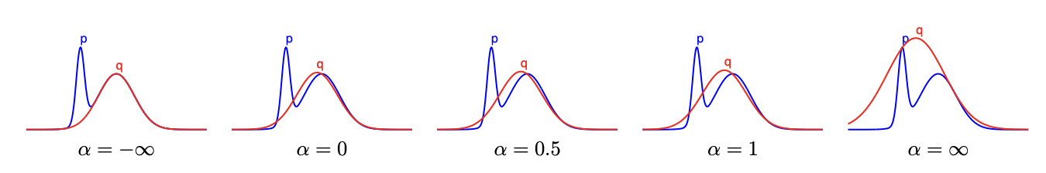

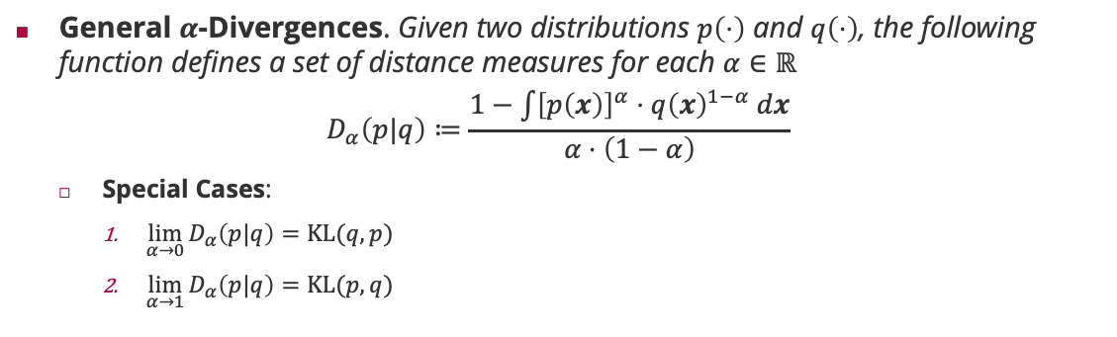


$α$-Divergences: Generalized Distances of Distributions
General $α$-Divergences. Given two distributions $p\left(⋅\right)$ and $q\left(⋅\right)$, the following function defines a set of distance measures for each $α∈ℝ$
$$D_{α}\left(p|q\right)≔\frac{1−\int{{\left[p\left(x\right)\right]}^{α}⋅{q\left(x\right)}^{1−α} dx}}{α⋅\left(1−α\right)}$$
Special Cases:
$\lim_{α→0}{D_{α}\left(p|q\right)=KL(q,p)}$
$\lim_{α→1}{D_{α}\left(p|q\right)=KL(p,q)}$
Tom Minka
mode seeking of $p$
covering whole support of $p$

Slide 27


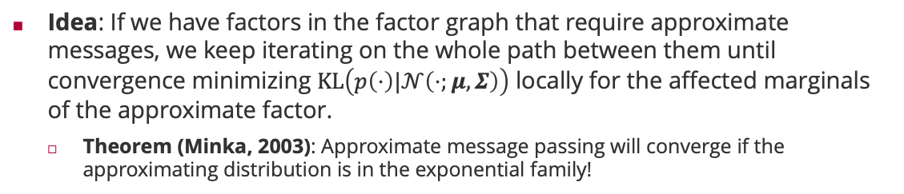



Expectation Propagation
Idea: If we have factors in the factor graph that require approximate messages, we keep iterating on the whole path between them until convergence minimizing $KL\left(p\left(⋅\right)|𝒩\left(⋅;μ,Σ\right)\right)$ locally for the affected marginals of the approximate factor.
Theorem (Minka, 2003): Approximate message passing will converge if the approximating distribution is in the exponential family!
Tom Minka
1
1
1
$$x_{1}$$
$$x_{2}$$
$$x_{5}$$
8
4
7
8
2
5
$$x_{3}$$
$$x_{4}$$
3
6

Slide 28
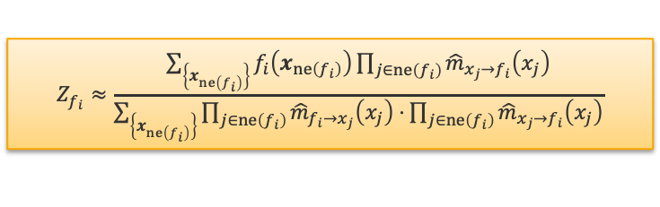
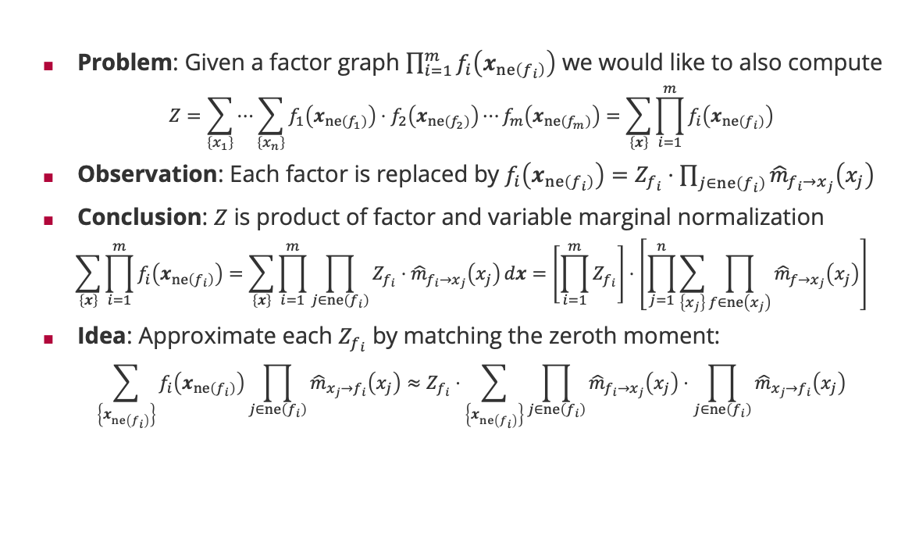
Approximating the Normalization Constant
Problem: Given a factor graph $\prod_{i=1}^{m}{f_{i}\left(x_{ne\left(f_{i}\right)}\right)}$ we would like to also compute
$$Z=\sum_{\left\{x_{1}\right\}}{⋯\sum_{\left\{x_{n}\right\}}{f_{1}\left(x_{ne\left(f_{1}\right)}\right)⋅f_{2}\left(x_{ne\left(f_{2}\right)}\right)⋯f_{m}\left(x_{ne\left(f_{m}\right)}\right)}}=\sum_{\left\{x\right\}}{\prod_{i=1}^{m}{f_{i}\left(x_{ne\left(f_{i}\right)}\right)}}$$
Observation: Each factor is replaced by $f_{i}\left(x_{ne\left(f_{i}\right)}\right)=Z_{f_{i}}⋅\prod_{j∈ne\left(f_{i}\right)}{{\hat{m}}_{f_{i}→x_{j}}\left(x_{j}\right)}$
Conclusion: $Z$ is product of factor and variable marginal normalization
$$\sum_{\left\{x\right\}}{\prod_{i=1}^{m}{f_{i}\left(x_{ne\left(f_{i}\right)}\right)}}=\sum_{\left\{x\right\}}{\prod_{i=1}^{m}{\prod_{j∈ne\left(f_{i}\right)}{Z_{f_{i}}⋅{\hat{m}}_{f_{i}→x_{j}}\left(x_{j}\right)}dx}}=\left[\prod_{i=1}^{m}{Z_{f_{i}}}\right]⋅\left[\prod_{j=1}^{n}{\sum_{\left\{x_{j}\right\}}{\prod_{f∈ne\left(x_{j}\right)}{{\hat{m}}_{f→x_{j}}\left(x_{j}\right)}}}\right]$$
$\text{Idea}\text{: }\text{Approximate} \text{each} Z_{f_{i}}$ by matching the zeroth moment:
$$\sum_{\left\{x_{ne\left(f_{i}\right)}\right\}}{f_{i}\left(x_{ne\left(f_{i}\right)}\right)\prod_{j∈ne\left(f_{i}\right)}{{\hat{m}}_{x_{j}→f_{i}}\left(x_{j}\right)}}≈Z_{f_{i}}⋅\sum_{\left\{x_{ne\left(f_{i}\right)}\right\}}{\prod_{j∈ne\left(f_{i}\right)}{{\hat{m}}_{f_{i}→x_{j}}\left(x_{j}\right)}⋅\prod_{j∈ne\left(f_{i}\right)}{{\hat{m}}_{x_{j}→f_{i}}\left(x_{j}\right)}}$$
One normalization per factor
$$Z_{f_{i}}≈\frac{\sum_{\left\{x_{ne\left(f_{i}\right)}\right\}}{f_{i}\left(x_{ne\left(f_{i}\right)}\right)\prod_{j∈ne\left(f_{i}\right)}{{\hat{m}}_{x_{j}→f_{i}}\left(x_{j}\right)}}}{\sum_{\left\{x_{ne\left(f_{i}\right)}\right\}}{\prod_{j∈ne\left(f_{i}\right)}{{\hat{m}}_{f_{i}→x_{j}}\left(x_{j}\right)}⋅}\prod_{j∈ne\left(f_{i}\right)}{{\hat{m}}_{x_{j}→f_{i}}\left(x_{j}\right)}}$$
Influence of all other factors on the zeroth moment approximation

Slide 29
Summary
Graphical Models
Simple way to visualize the product structure of a joint probability distribution
Useful for modelling real-life data generating processes
Allows both to test for conditional independence and efficient marginalization
Bayesian Networks and Conditional Independence
A directed acyclic graph where each edge points from a conditioning to a conditioned variable in the model
d-separation is a set of simple rules (”blocking”) to read off conditional independence
Factor Graphs and Sum-Product Algorithm
Application of generalized distributive law
Trades memory (“messages”) for computation (“sums”)
Approximate Message Passing and Expectation Propagation
Approximations will always be done on the marginals, not the messages!
When the Kullback-Leibler divergence is used as distance, all moments get preserved!

Slide 30
See you next week!

